Slide 1



Detection of Basal Cell Carcinoma in Whole Slide Images
Authors: Hongyan Xu , Dadong Wang , Arcot Sowmya , and Ian Katz
International Conference on Medical Image Computing and Computer-Assisted Intervention (MICCAI 2023)
Paper Publication Date: 01 October 2023
Reporter Name : Sohaib Asif (宋海泊)

Slide 2

Contents.
01
目录
02
Introduction
Method
03
04
Experimental
Results
Conclusion
Central South University

Slide 3


Introduction
1
Skin cancer is the most prevalent cancer worldwide, with increasing incidences over recent decades.
Basal cell carcinoma (BCC) accounts for 70% of skin cancer cases and has experienced a surge of 20–80% in the last 30 years.
Timely diagnosis of BCC is crucial for effective treatment and to alleviate the burden on healthcare resources.
Scanned traditional histology slides result in whole slide images (WSIs), which can be analyzed by deep learning models.
Current skin cancer detection methods often utilize models designed for natural images, such as Inception Net and ResNet.
Neural Architecture Search (NAS) addresses the issue by auto-designing superior models and exploring a vast architecture space.
Central South University

Slide 4
Challenges
2
Efficiency and Resource
Allocation:
1
Rising Incidences and Healthcare Strain:
4
The increasing global incidence of skin cancer, particularly basal cell carcinoma (BCC), poses a significant challenge, leading to an added strain on healthcare resources.
Efficient analysis of whole slide images (WSIs) using deep learning models is promising, but the implementation of these technologies requires substantial resources, including computational power and trained personnel.
CHALLENGES
2
Timely Diagnosis Complexity:
Timely diagnosis of BCC is crucial, but the complexity of histological evaluation as the gold standard can lead to delays and hinder the prompt initiation of treatments.
Fairness in NAS:
5
The current challenge in NAS methods lies in ensuring fairness in architecture ranking, as overlooking this aspect may result in the neglect of top-performing models for skin cancer detection, impacting overall effectiveness.
3
Model Adaptation for Skin Pathology:
Existing skin cancer detection methods, utilizing models designed for natural images, face challenges in adapting to the unique pathology of skin tissue, affecting the accuracy of diagnoses.
自强不息 厚德载物
Central South University

Slide 5




Major Contributions
3
NAS Approach for Optimal Network Identification:
The study utilized (NAS) to identify the optimal network architecture specifically tailored for skin cancer detection, aiming to enhance the accuracy of diagnostic models.
Fairness Ranking in NAS:
The study highlighted a common limitation in conventional NAS methods, emphasizing that fairness ranking is often overlooked during the search for optimal solutions. SC-Net addresses this by incorporating fair training and precise ranking in its framework.
Development of SC-Net Framework:
The researchers introduced a novel framework called SC-net, designed to improve the efficiency and accuracy of the NAS approach. SC-net focuses on identifying highly valuable architectures for skin cancer detection.
.
Efficacy of SC-Net:
Experimental results demonstrated the efficacy of the SC-net framework, showcasing notable performance improvements. The ResNet50 model achieved a top-1 accuracy of 96.2% and an AUC of 96.5%, outperforming baseline methods by 4.8% and 4.7%, respectively.
自强不息 厚德载物
Tsinghua University of China
Central South University

Slide 6
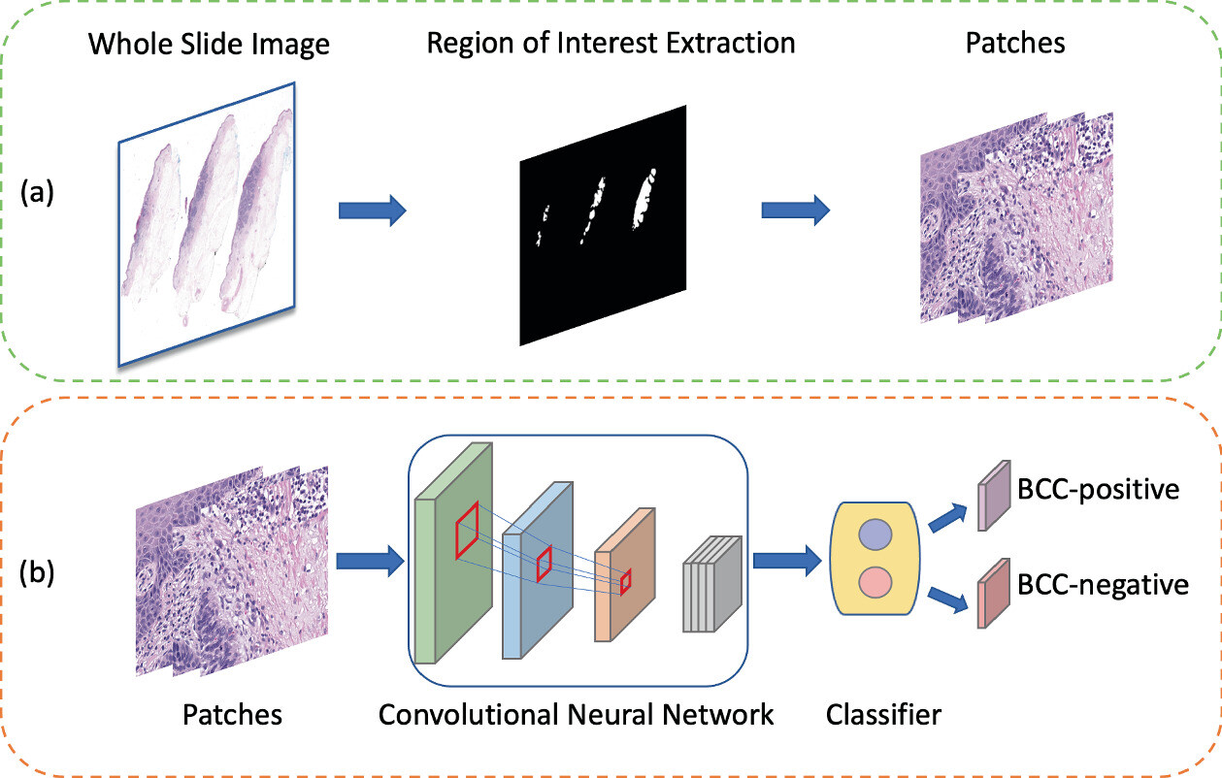
Methodology
4
Figure 1 shows the proposed framework, which integrates two modules. Module (a) extracts the region of interest (ROI) from WSI and generates patches, while Module (b) uses optimal model architecture from NAS to analyze features from patches and generate classiﬁcations.
Central South University

Slide 7
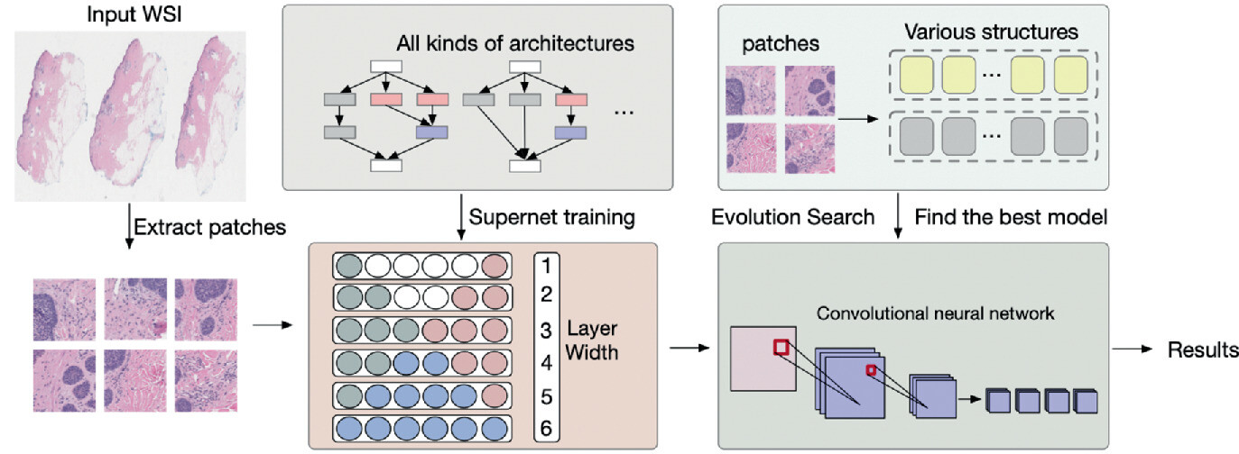
Materials & Methodology
5
The proposed method, involves dividing the input Whole Slide Image into patches. These patches are utilized for both training a supernet and conducting the search for optimal architectures.
The study employs a balanced evolutionary algorithm to navigate the search space and select the optimal architecture. This algorithm considers the diversity and performance of candidate structures within the search space.
The selected candidate structures from the evolutionary algorithm undergo performance evaluation using mini-batch patch data on a skin cancer dataset. This step assesses the effectiveness of the searched architectures in the context of skin cancer detection.
Central South University

Slide 8
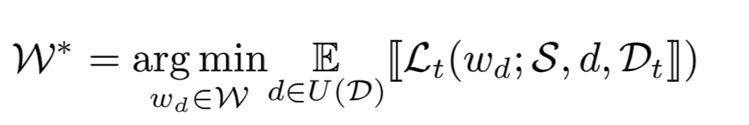
One-Shot Channel Number Search
6
To extract an optimal architecture from a vast search space, a weight sharing strategy is used to prevent training from scratch.
The search leverages a supernet S with weights W, with each path γ inheriting weights from W. This makes one-shot NAS a two-step optimization process: supernet training and architecture search. The original dataset is typically split into training Dt and validation datasets Dv. The weights W of the supernet S are trained by uniformly sampling the network width d and optimizing the sub-network with weights wd ⊂ W.
Where U (D) is a uniform distribution of network widths, E is the expected value of random variables, and Lt is the training loss function. Then, the optimal network width d∗ corresponds to the network width with the best performance (e.g. classiﬁcation accuracy) on the validation dataset.
Where Fp is the resource budget of FLOPs. The search for Eq. 2 can be eﬃciently performed by various algorithms, such as random or evolutionary search
Central South University

Slide 9
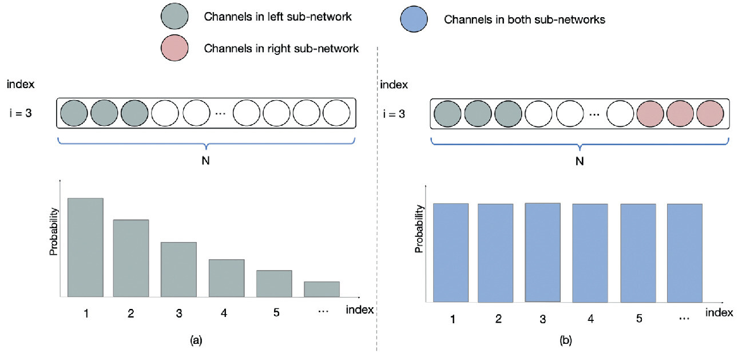
SC-Net as a Balanced Supernet
7
Existing NAS approaches, commonly employ a unilaterally augmented (UA) principle for evaluating widths. This may lead to a bias in training channels within the supernet, indicating a potential limitation in the fairness of augmentation strategies..
In the UA principle, some channels are trained twice while others are trained only once or not at all, leading to channel training unfairness and evaluation bias.
Channels with smaller indices are used for various sizes, resulting in over-training of the left channel kernels since widths are uniformly sampled.
In contrast, proposed SC-Net method ensures that all channels are trained evenly (twice) by training both the width d and its complementary width.
Central South University

Slide 10
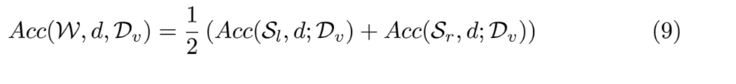
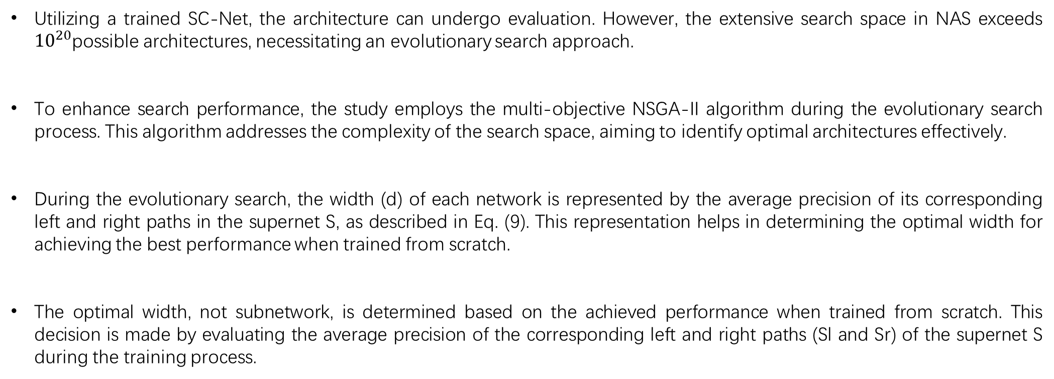
Balanced Evolutionary Search with SC-Net
8
Utilizing a trained SC-Net, the architecture can undergo evaluation. However, the extensive search space in NAS exceeds ${10}^{20}$possible architectures, necessitating an evolutionary search approach.
To enhance search performance, the study employs the multi-objective NSGA-II algorithm during the evolutionary search process. This algorithm addresses the complexity of the search space, aiming to identify optimal architectures effectively.
During the evolutionary search, the width (d) of each network is represented by the average precision of its corresponding left and right paths in the supernet S, as described in Eq. (9). This representation helps in determining the optimal width for achieving the best performance when trained from scratch.
The optimal width, not subnetwork, is determined based on the achieved performance when trained from scratch. This decision is made by evaluating the average precision of the corresponding left and right paths (Sl and Sr) of the supernet S during the training process.
Central South University

Slide 11
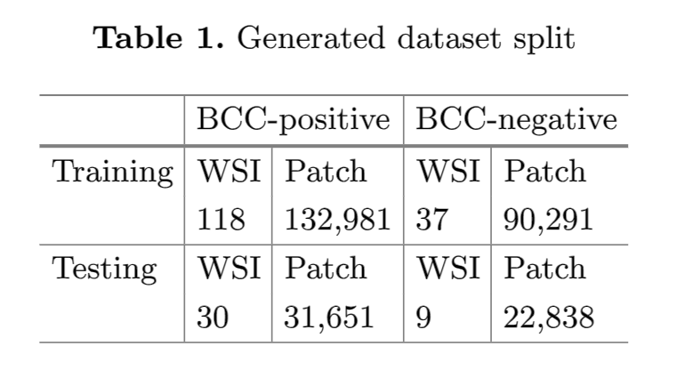
Experiments
9
The experimental setup involved training models on two NVIDIA RTX A6000 GPUs using PyTorch.
These models, initialized from a zero-mean Gaussian with standard deviation σ = 0.001, were trained for 200 epochs with a batch size of 256.
Training used the Adam optimizer with a dynamic learning rate reduction strategy, starting with a learning rate of 5e-5 following a cosine schedule.
The dataset, comprised of 194 skin slides acquired from the Southern Sun Pathology laboratory, includes 148 BCC cases and 46 other types.
Central South University

Slide 12
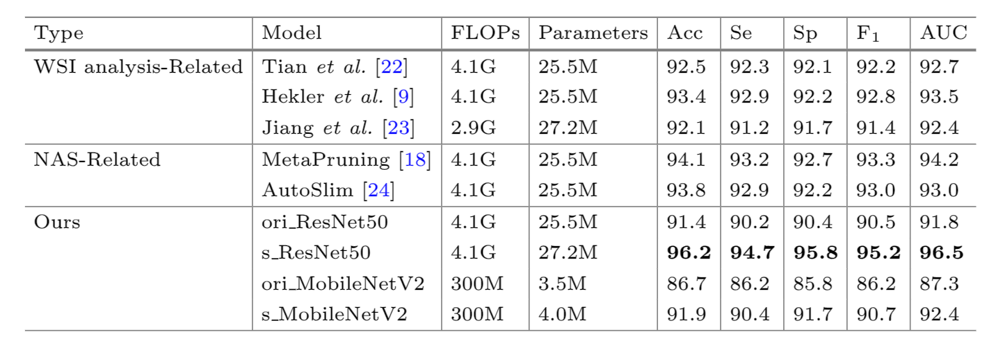
Performance Evaluation
10
Both heavy and light models were tested during the validation process.
The study conducted a search on ResNet50 and MobileNetV2 models, comparing the results against the original ResNet50 (ori ResNet50) and MobileNetV2 (ori MobileNetV2) models used as baselines. The resulting models from the search process were denoted as s ResNet50 and s MobileNetV2.
Selected several papers in the ﬁeld of pathological image analysis, such as [9,22,23], as well as others using the UA principle, such as [18,24].
Central South University

Slide 13
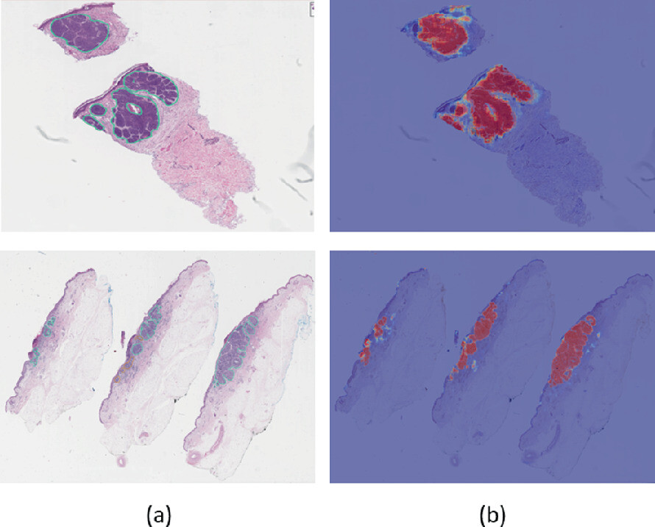
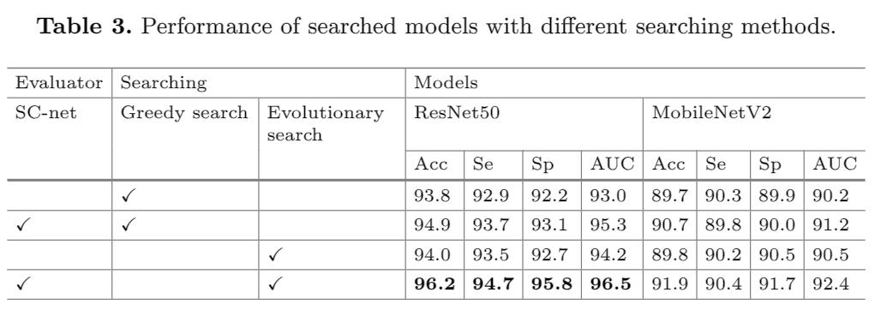
Performance Evaluation
11
Visualization of Probability Heatmaps
A comparison between the labeled areas in Column (a) and the red areas in Column (b) reveals a generally similar scope, indicating that the ResNet50 accurately identifies regions of interest for Basal Cell Carcinoma (BCC) diagnosis
Ablation Study
The SC-net (second row) under greedy search improved accuracy by 1.1% (ResNet50) and 1.0% (MobileNetV2), while with evolutionary search, accuracy increased by 1.8% (ResNet50) and 2.1% (MobileNetV2). These results highlight SC-net’s eﬀectiveness as a supernet in bolstering evaluation and search performance.
Central South University

Slide 14
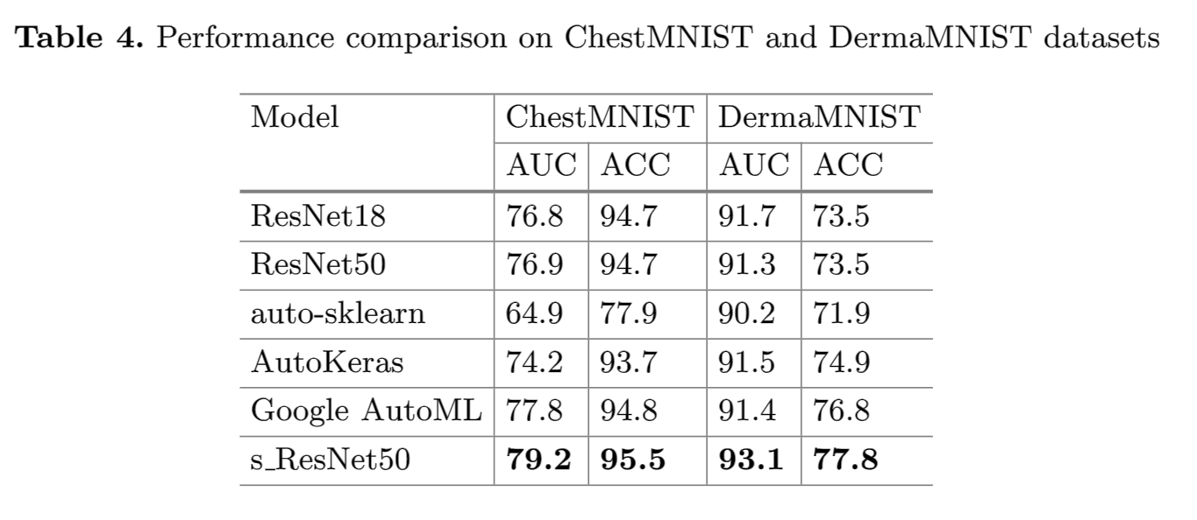
Generalization Ability of SC-net.
12
They tested model’s generalization on the ChestMNIST and DermaMNIST subsets of MedMNISTv2, following established protocols. As shown in Table 4, s_ResNet50 surpassed the original ResNet50 on all datasets, gaining 2.3% and 1.8% more AUC on ChestMNIST and DermaMNIST respectively, proving the model’s robust generalization.
Conclusion
The paper introduces SC-net, a novel NAS framework designed specifically for detecting skin cancer in pathology images. SC-net is formulated as a balanced supernet, ensuring fair ranking and treatment of all potential architectures.
Through the application of SC-net and an evolutionary search process, the study obtained optimal architectures. These architectures achieved notable improvements, reaching 96.2% Top-1 accuracy and 96.5% overall accuracy on a skin cancer dataset. These results signify enhancements of 4.8% and 4.7% over baseline models.
The paper outlines plans for future work, indicating the intention to apply the developed approach to larger datasets for wider-scale validation. This suggests a commitment to assessing the scalability and generalizability of the proposed SC-net framework in broader contexts
Central South University

Slide 15
Thanks for listening

